Slide 1

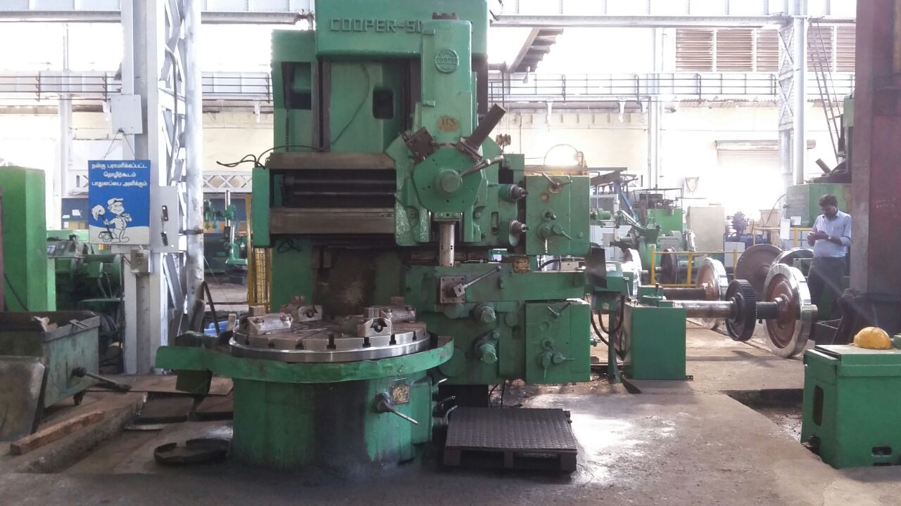
Vertical turret lathe

Slide 2
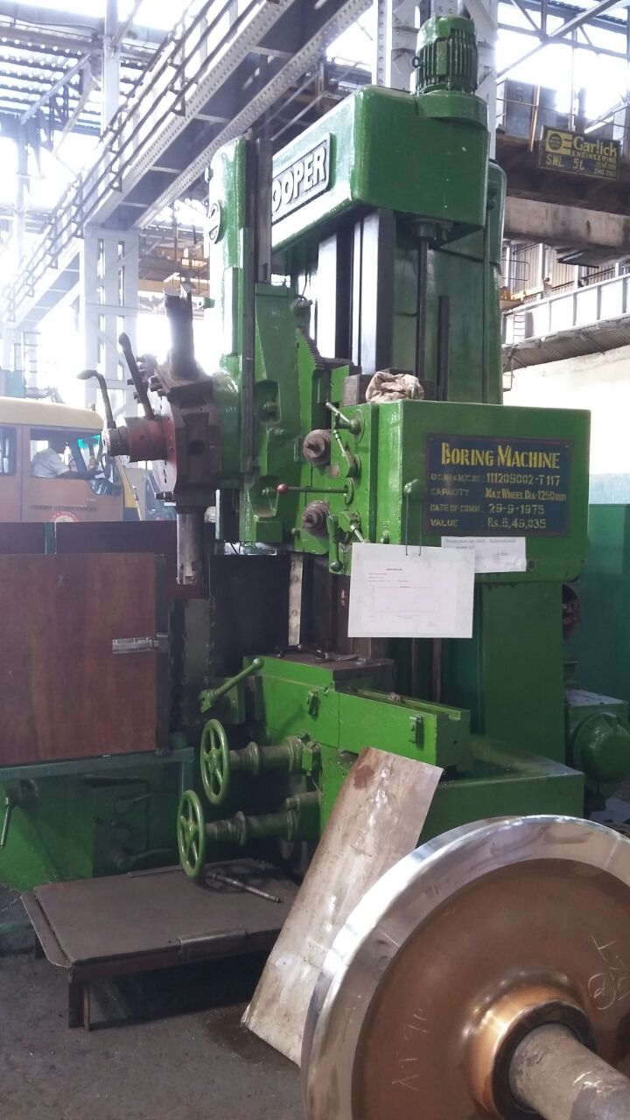
Typical defects faced & how tackled
Motor replaced
Overload protection set precisely
Single phasing preventer provided

Slide 3
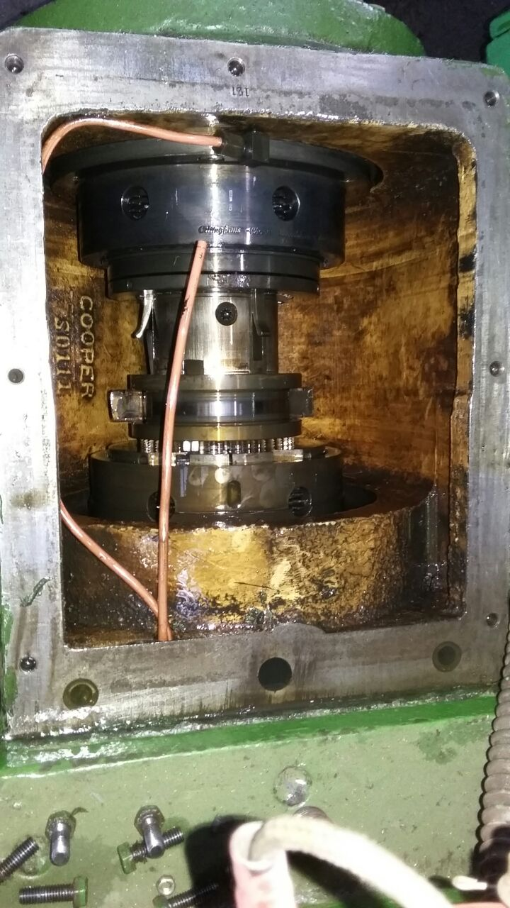
Hydraulic operated clutch defect
Sintered brasstype
Clutch plates removed
Local source identified
procured&replaced
Enough stock kept

Slide 4
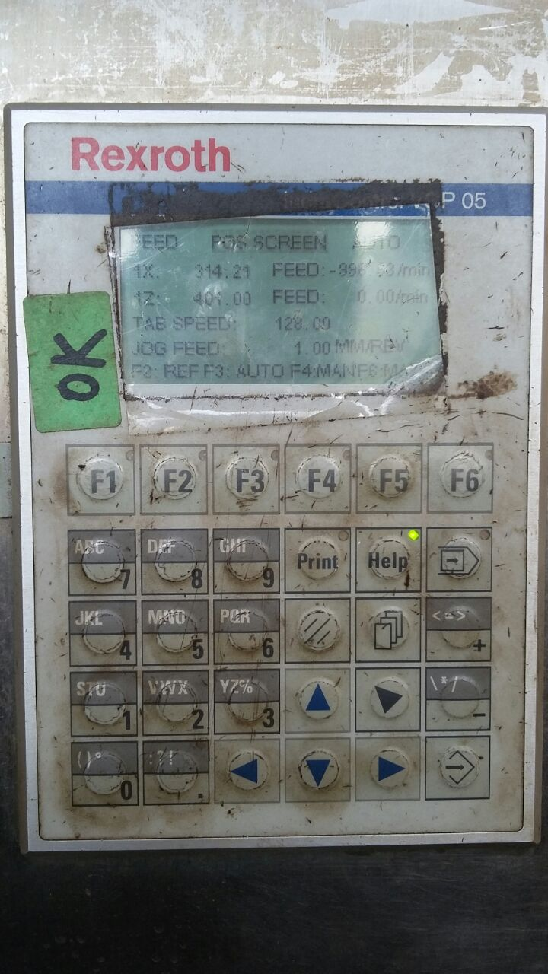
PLC defect
Referencing defect
Entire PLC replaced
OEM supported even after warranty
All parameters restored

Slide 5
Unsolved failures
Kirloskar VTL
Size variation
Handling
Wear in screw rod/box
Wedge wear
HMT VTL
Incorrect indexing
Repeated failure
Design change

Slide 6
Inputs required to bridge the gap
Training from OEM on maintenance and trouble shooting
To provide all backup data like parameter etc
To spare one fully loaded hard disk
Spares availability and their price should be available during commisioning
COFMOW should include one complete set of critical spares whenever machines are procured in more numbers

Slide 7
Inputs required
Complete functioning of NCU-SIEMENS
ALARAM display details and to solve them
Incase of specific file getting corrupted -steps for restoration
In addition to creating WAP group,website etc..
Spares pooling
Roping in OEMs to the extant possible to have expert opinion for the unsolved problems

Slide 8
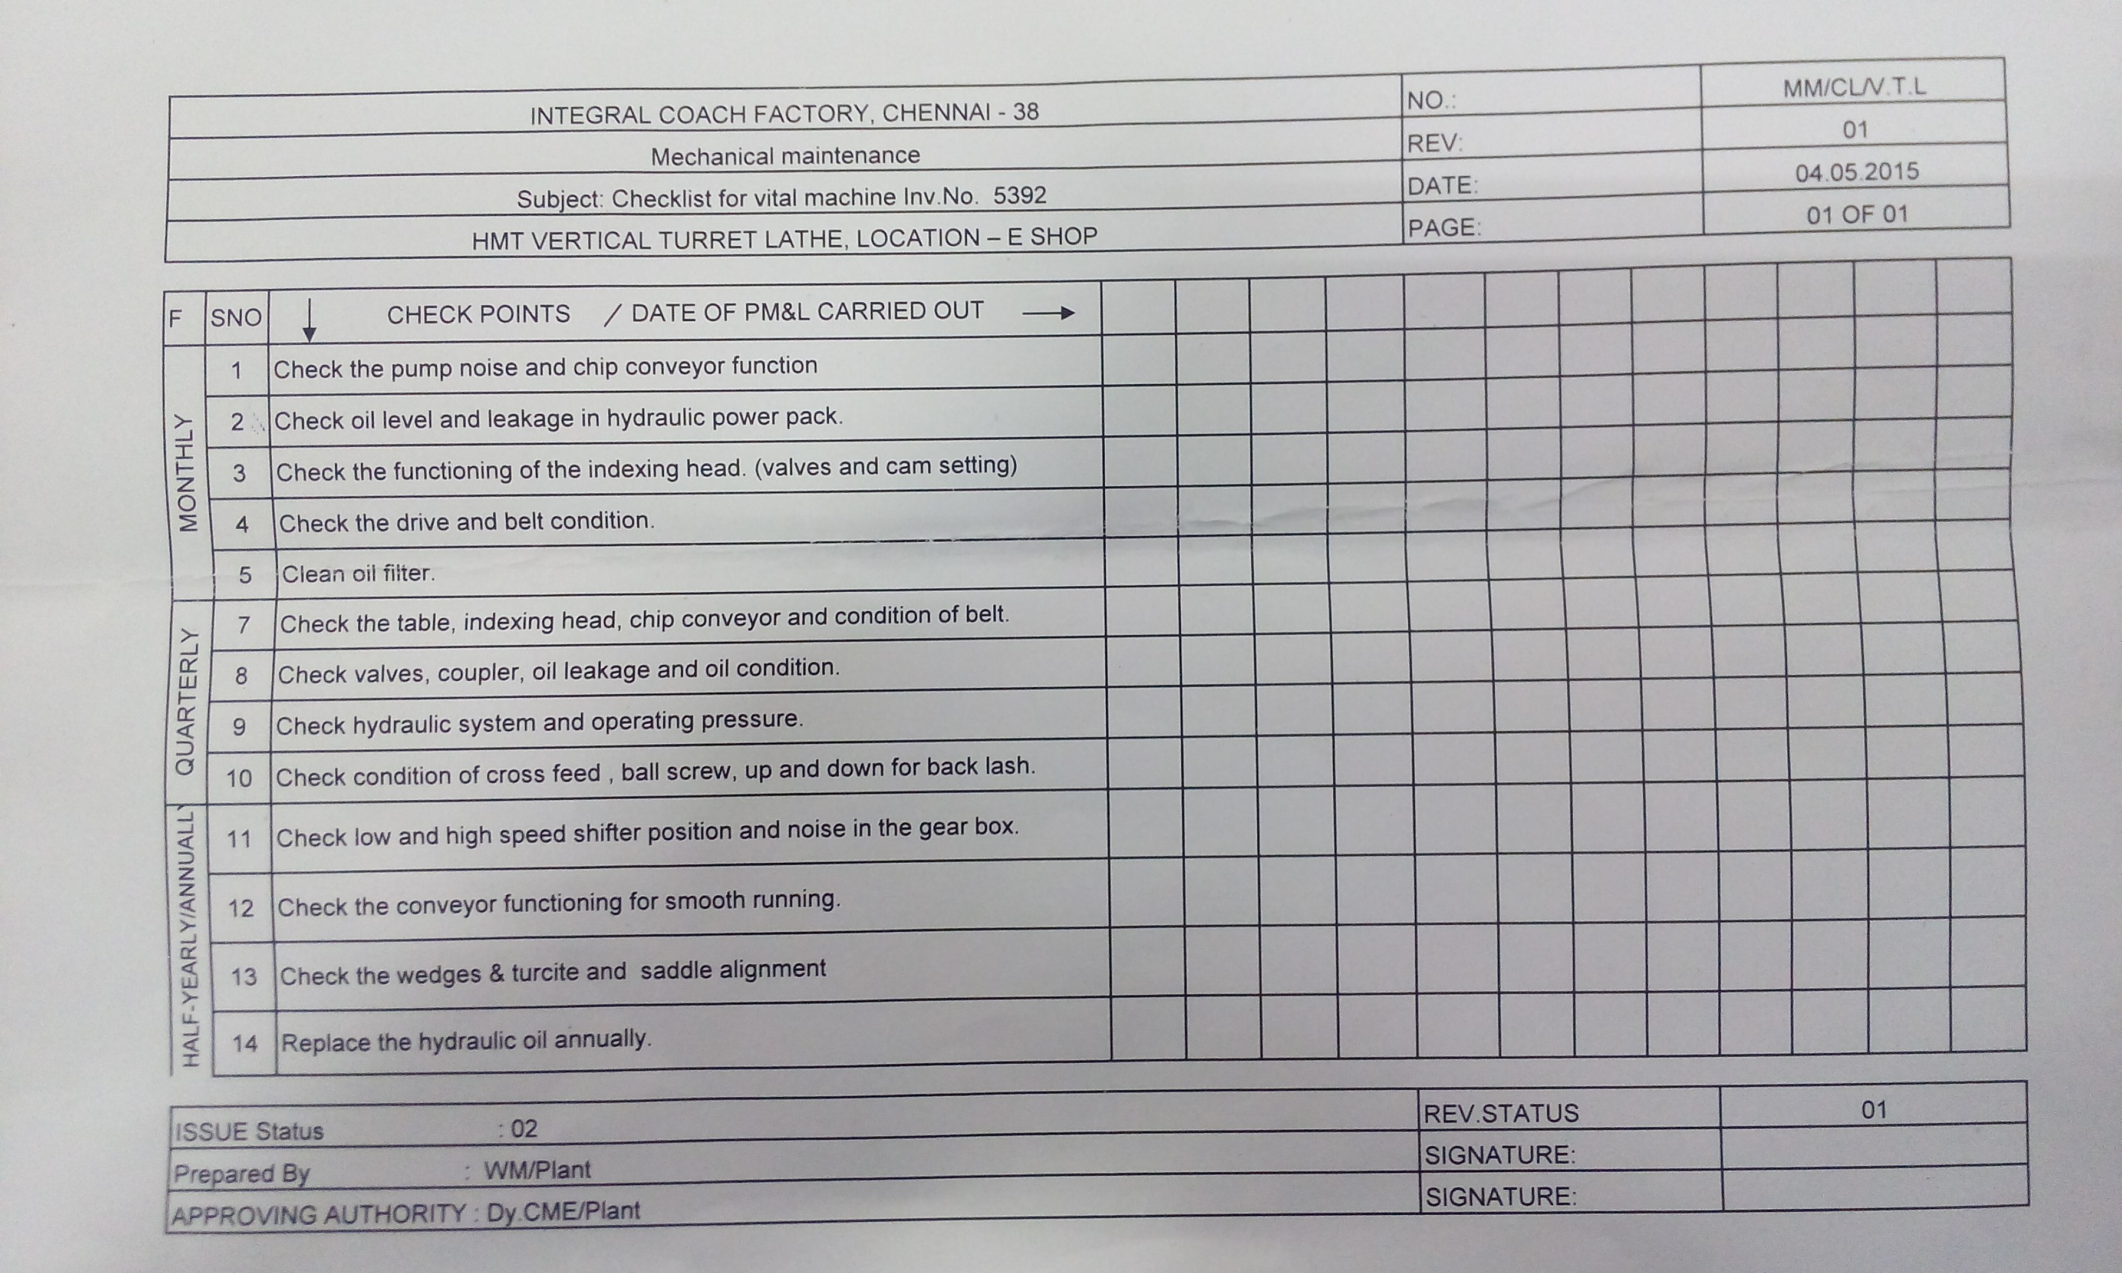
PREVENTIVE MAINTENANCE SCHEDULE STANDERDISATION

